Slide 1

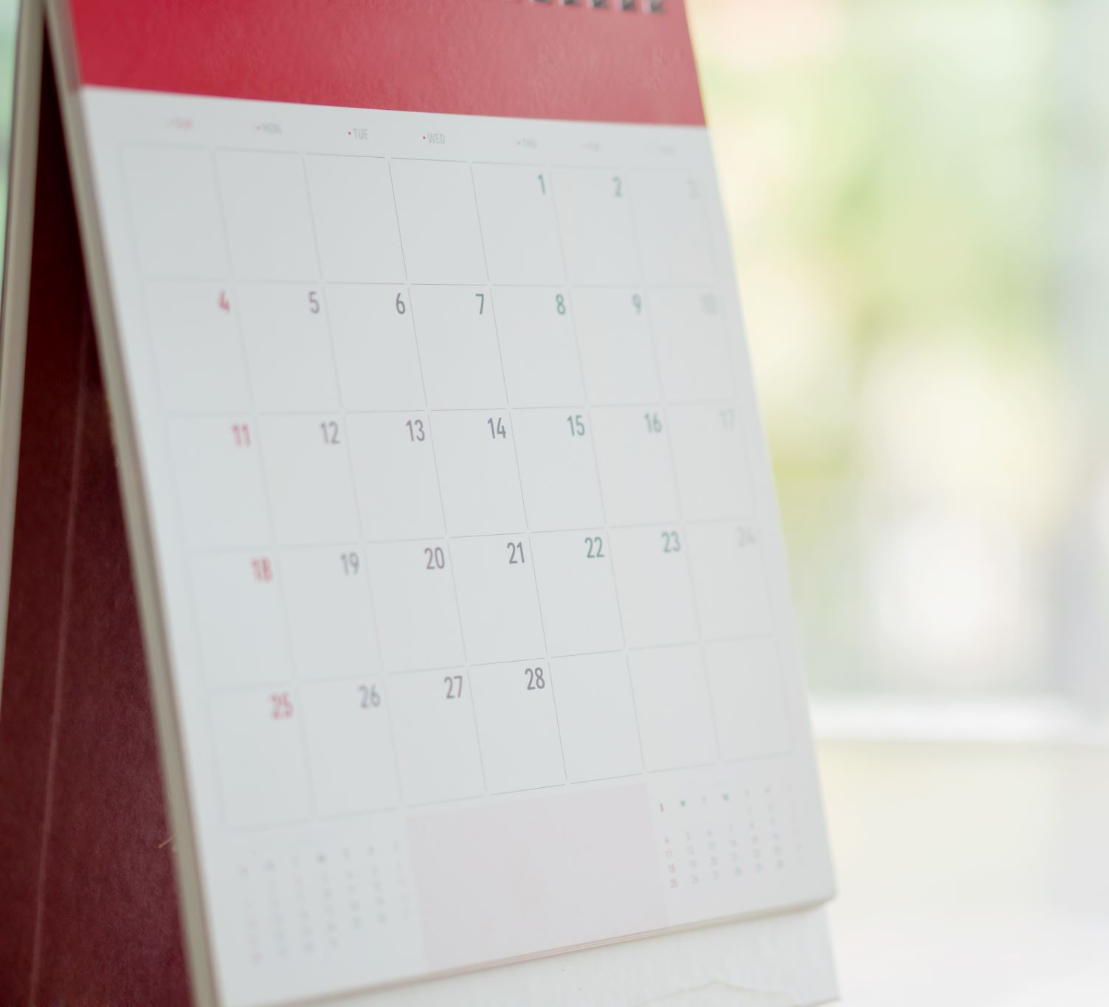
Week 11-14
Heston Moyers
Self Reflective Journal

Slide 2
Week 11
This week I have had the opportunity to focus on my professional behavior. I think it is so important to have a relationship with my instructor and the other members of the class so I can ask for assistance outside my group. This week my goal is to post on external sites/forums and help others achieve the goal of basic.

Slide 3
Week 12
I have finished all of my professional behavior and plan to submit it all next week. I have learned so much this semester and can't wait to use the things I have learned in my career and life.

Slide 4
Week 13
This week I was not able to get very much accomplished. My wife had our second child on Monday and I have been helping and supporting her. One thing that I have learned is that My learning with my family and showing them that I am interested in their lives is just as important as my school work. They are everything to me and will always be there for me when times get tough.
My wife is a superhero and had our second child a baby girl named Liv Loren Moyers. She was born 8 pounds 20.5 inches long.

Slide 5
Week 14
This week I am gathering all of my deliverables and submitting all of my assignments for feedback.

